Slide 1
PROGRAMA EJECUTIVO EN DE IA Y DEEP LEARNING On-line Módulo Implantación Tecnológica. Torch, Tensorflow y Keras

Slide 2

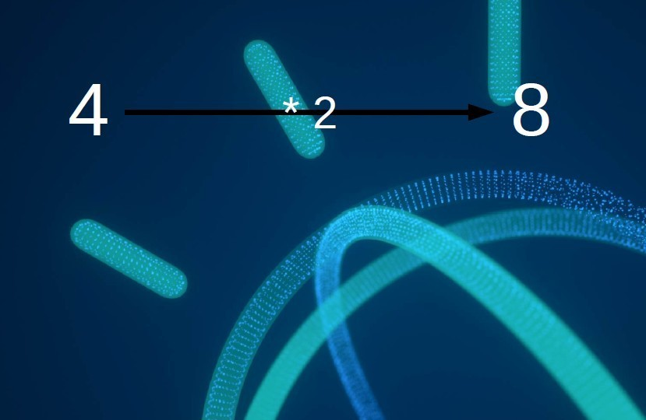
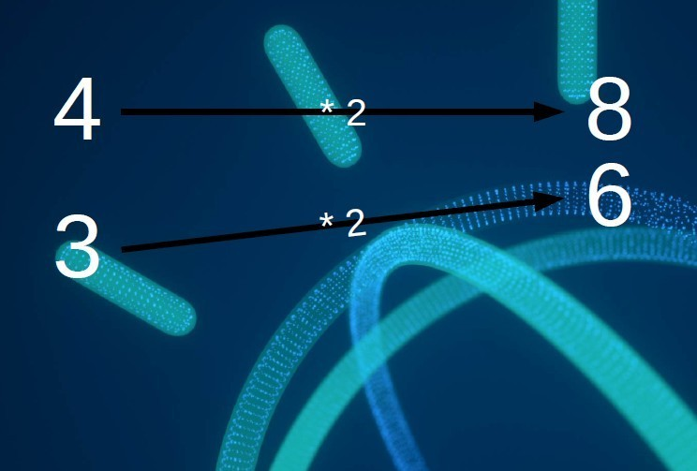
Explicación RED NEURONAL

Slide 3
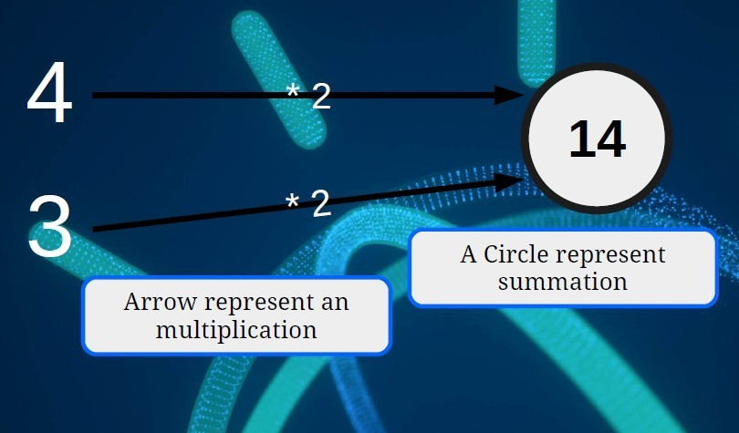
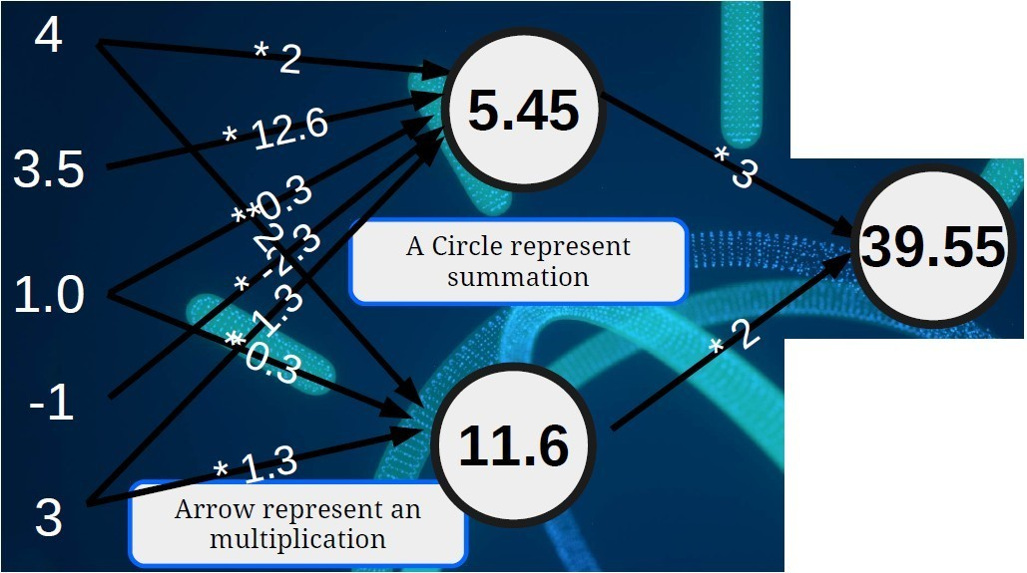
Explicación RED NEURONAL

Slide 4
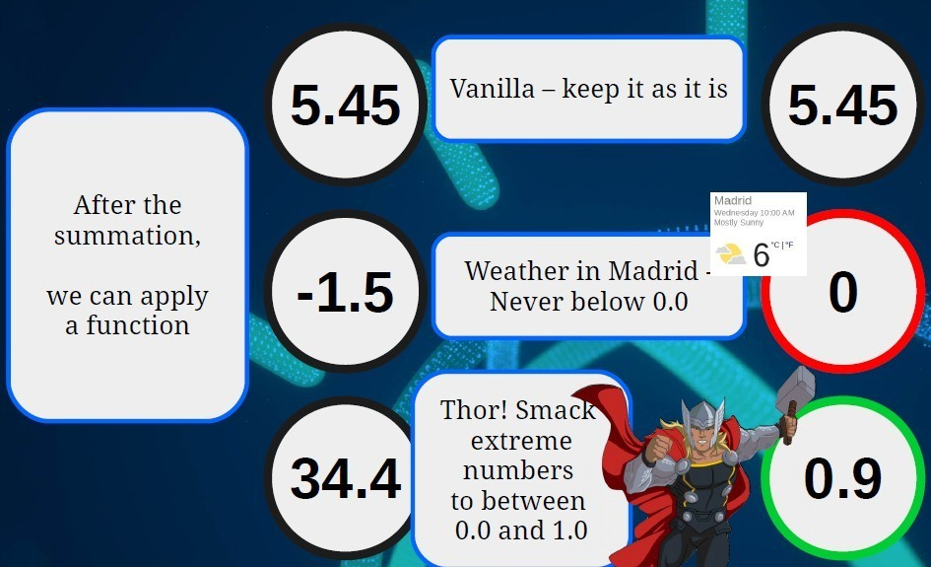
Explicación RED NEURONAL

Slide 5
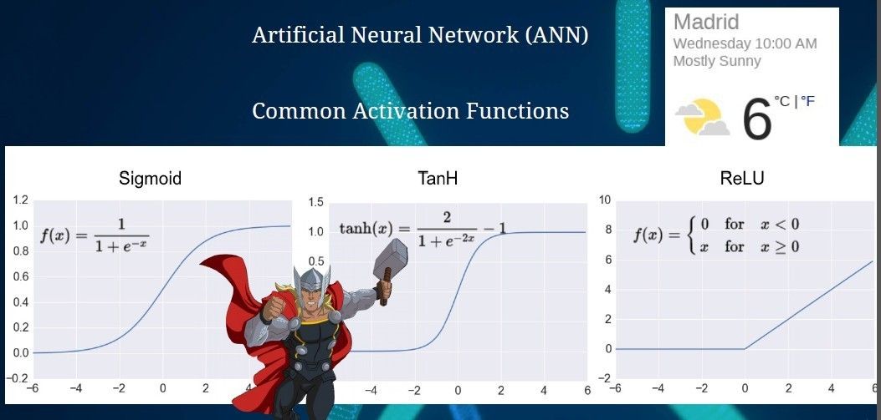
Explicación RED NEURONAL

Slide 6
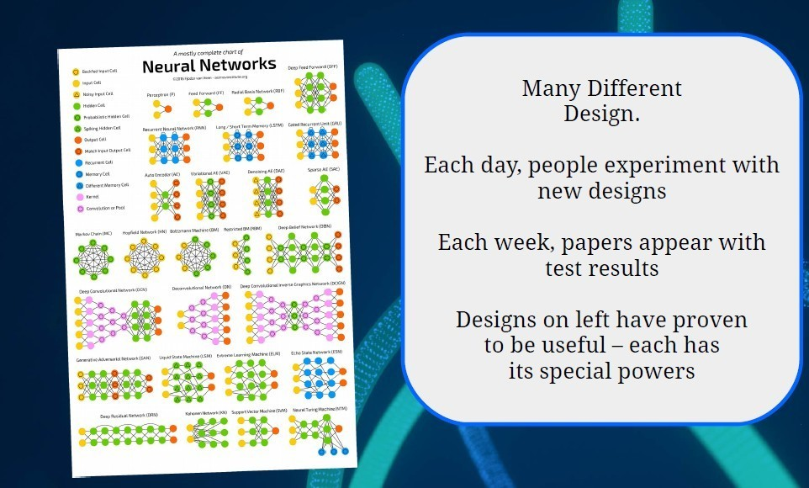
Explicación RED NEURONAL

Slide 7
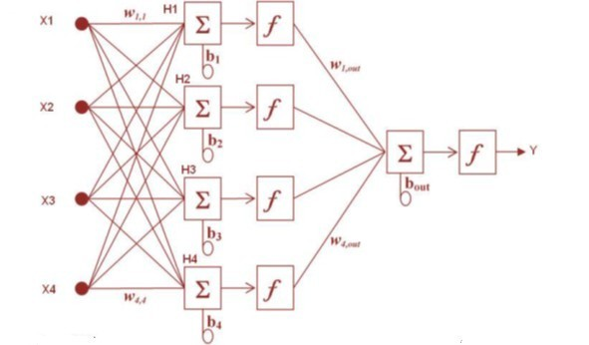
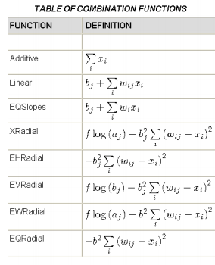
Deep Learning – Red Neuronal Explicación
Combination functions o funciones de combinación
*It is usually the sum of each entry multiplied by the assigned weight.

Slide 8
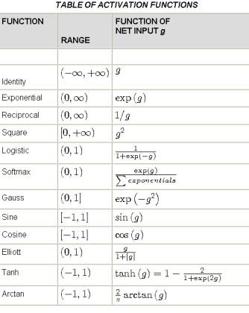
Deep Learning – Red Neuronal Explicación
Activation functions o funciones de activación
*Its mission is to modify the combination. It does not always appear, coinciding in these cases with the said propagation (combination).

Slide 9
Deep Learning – Red Neuronal Explicación
Objective Function o función objetivo
Optimization algorithms estimate the parameters facing minimize an error function.
In regression, if the distribution of the output variable is known (by Normal, Lognormal or Gamma example), can be used as a function
objective the maximum likelihood.
As a general rule, we will use a nonparametric approach in regression,
taking as its objective function the default function, which is the sum or average of squared errors.
The selection of the objective function will be more important in Classification.

Slide 10
Deep Learning – Red Neuronal Explicación
Resumiendo, se usan esas tres funciones para aprender el algoritmo que definirá el modelo. Los algoritmos aprenden a través de la modificación de los pesos “weights” de las neuronas

